Slide 1
Node.js
IN712 Web 3

Slide 2
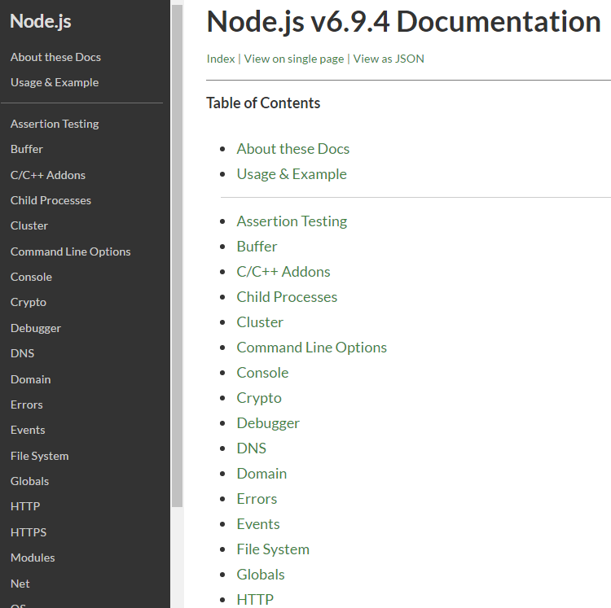
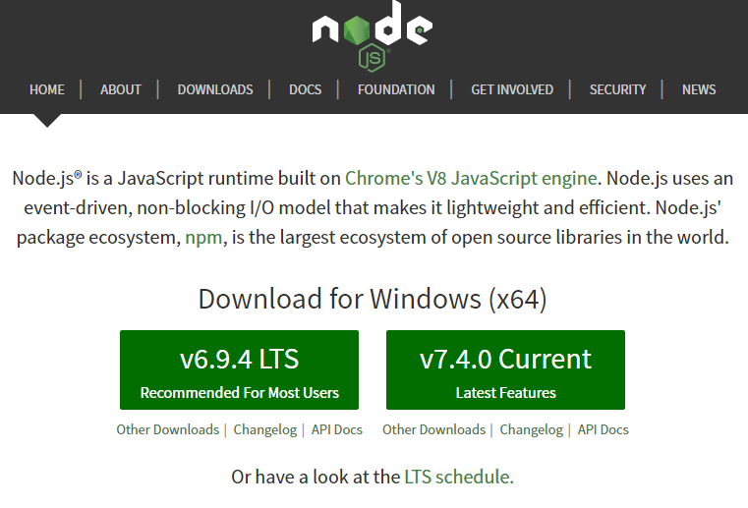
Introduction to node.js
Node.js is an open-source cross platform runtime environment for server-side and networking applications
It is built on top of Chrome's, V8, JavaScript runtime engine
Applications for Node are written in JavaScript.
This is why many developers like Node because it's lightweight and you can write your front-end and back-end in the same language,

Slide 3
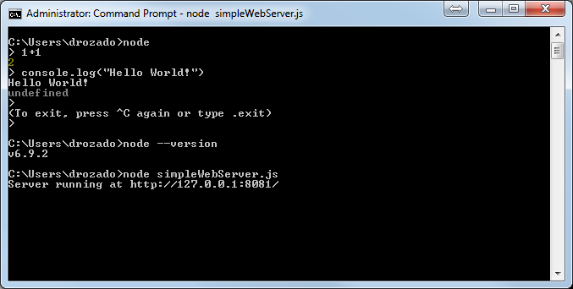
Introduction to node.js
Once you have installed node.js, you have access to node command line interface (CLI)

Slide 4
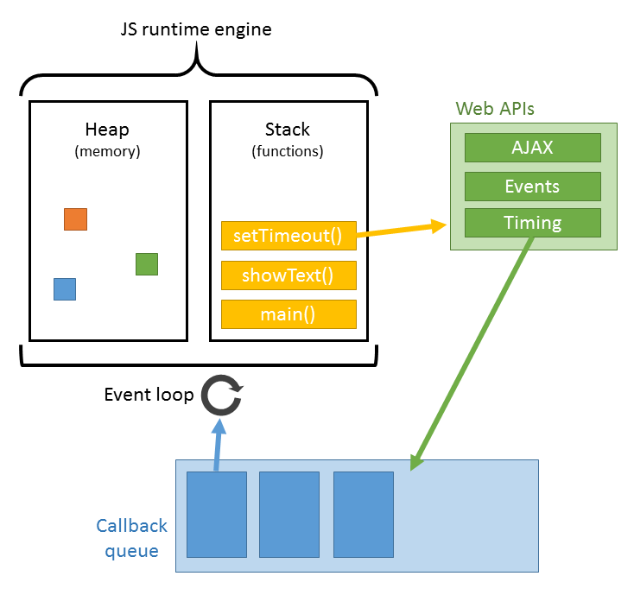
Features of node.js
Asynchronous: all APIs of node are asynchronous, that is, nonblocking. The node.js interpreter does not wait for a function to return a value. The interpreter moves to the next line
Very fast: built on Google Chrome’s V8 JavaScript engine
Single threaded: node.js uses a single threaded model using an event loop
Event driven: the event loop makes the interpreter respond in a non-blocking way
Highly scalable: as opposed to traditional servers which create an exclusive thread to handle every request (for instance Apache), node.js uses a single thread which can service a much larger number of requests
No buffering: node.js does not buffer data, it outputs data in chunks
Free software license: MIT license

Slide 5
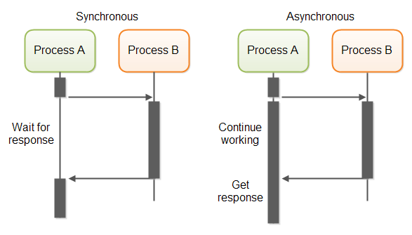
Understanding asynchronous tasks
When you execute a task synchronously, you wait for it to finish before moving on to another task, which is what causes blocking
When you execute tasks asynchronously, you can move on to another task without having to wait for the previous task to finish.

Slide 6
When/Where does asynchronous programming make sense?
If you've ever used an application or a website not using Ajax where you had to submit the form, and everything went froze until the response was received, that's the background process running synchronously and blocking the responsiveness of the user interface until it completes.
If we were to make a list of all the things you could do on a computer and ordered them based on their completion time, there would be two that require relatively long waiting times:
networking access
file system access
With a web app, these are some of the most common functions. This is why Node performs so well for web apps.
The most common way to get started with asynchronous code is through callbacks

Slide 7
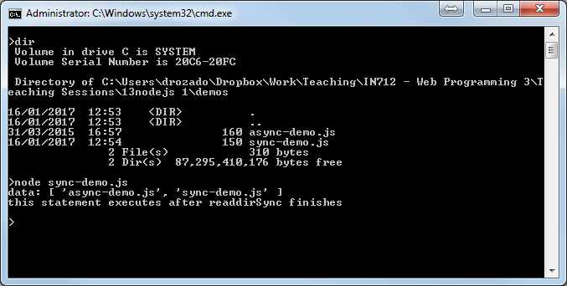
Synchronous programming
fs = require('fs');
data = fs.readdirSync('./');
console.log('data:', data);
console.log("this executes after readdirSync finishes");

Slide 8

Asynchronous programming
fs = require('fs');
function callbackFunc(err, data) {
console.log('data:', data);
}
fs.readdir('./', callbackFunc);
console.log("this executes before readdirSync finishes");

Slide 9
Node.js history
2009: node.js created by by Ryan Dahl
2011: NPM (node package manager) created. The package manager makes it easier for programmers to publish and share source code of Node.js libraries and is designed to simplify installation, updating and uninstallation of libraries
Conflicts started to emerge about the management of Node releases. The users wanted a project governed by the open-source community rather than a corporation (Joyent that sponsored Ryan Dahl). They also wanted to be able to incorporate the latest language and API features faster.
2014: io.js created a fork of the Node.js project and went onto release several versions of io.js.
February 2015: it was announced that a neutral Node.js foundation would be formed.
The Node.js foundation is made up of several large companies including IBM, Microsoft, PayPal, Groupon and Joyent.
September 2015 the Node.js foundation announced that the Node.js and io.js would be combined in a single code base and released as Node.js version 4.0.

Slide 10
For what sort of applications is node.js optimal?
Where to use node.js?
Applications heavy on input/output operations
Network intensive applications
Data intensive application ( streaming content)
JSON APIs
where not to use node.js?
cpu intensive applications

Slide 11
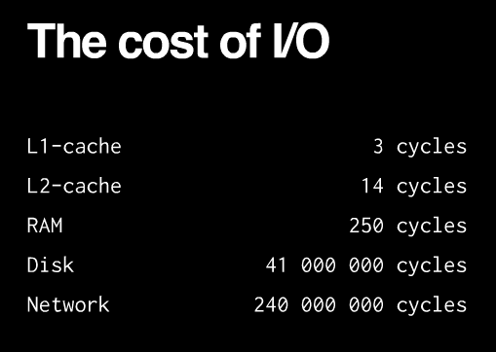
I/O is expensive

Slide 12
Node.js event loop
Remember JavaScript event loop?

Slide 13
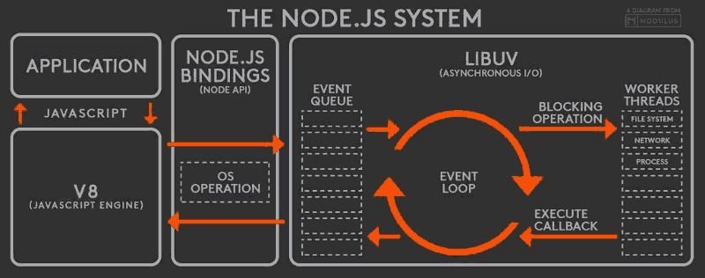
Node.js event loop
The event loop is single threaded
Nonblocking I/O task processes

Slide 14
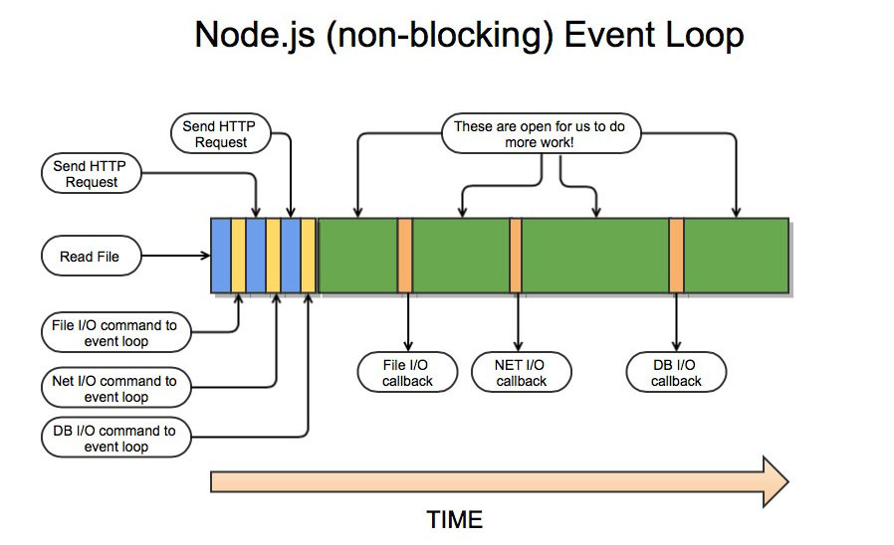
The advantage of asynchronous code

